Slide 1
UNIT - V
NP PROBLEMS
& APPROXIMATION ALGORITHMS

Slide 2
P, NP and NP-Complete Problems

Slide 3
Problem Types: Optimization and Decision
Optimization problem: find a solution that maximizes or minimizes some objective function
Decision problem: answer yes/no to a question
Many problems have decision and optimization versions.
E.g.: traveling salesman problem
optimization: find Hamiltonian cycle of minimum length
decision: find Hamiltonian cycle of length ≤ m
Decision problems are more convenient for formal investigation of their complexity.

Slide 4
Class P
P: the class of decision problems that are solvable in O(p(n)) time, where p(n) is a polynomial of problem’s input size n
Examples:
searching
element uniqueness
graph connectivity
graph acyclicity
primality testing

Slide 5
Class NP
NP (nondeterministic polynomial): class of decision problems whose proposed solutions can be verified in polynomial time = solvable by a nondeterministic polynomial algorithm
A nondeterministic polynomial algorithm is an abstract two-stage procedure that:
generates a random string purported to solve the problem
checks whether this solution is correct in polynomial time
By definition, it solves the problem if it’s capable of generating and verifying a solution on one of its tries

Slide 6
Example: CNF satisfiability
Problem: Is a boolean expression in its conjunctive normal form (CNF) satisfiable, i.e., are there values of its variables that makes it true?
This problem is in NP. Nondeterministic algorithm:
Guess truth assignment
Substitute the values into the CNF formula to see if it evaluates to true
Example: (A | ¬B | ¬C) & (A | B) & (¬B | ¬D | E) & (¬D | ¬E)
Truth assignments:
A B C D E
0 0 0 0 0
. . .
1 1 1 1 1
Checking phase: O(n)

Slide 7
What problems are in NP?
Hamiltonian circuit existence
Partition problem: Is it possible to partition a set of n integers into two disjoint subsets with the same sum?
Decision versions of TSP, knapsack problem, graph coloring, and many other combinatorial optimization problems. (Few exceptions include: MST, shortest paths)
All the problems in P can also be solved in this manner (but no guessing is necessary), so we have:
    P ⊆ NP
Big question: P = NP ?

Slide 8
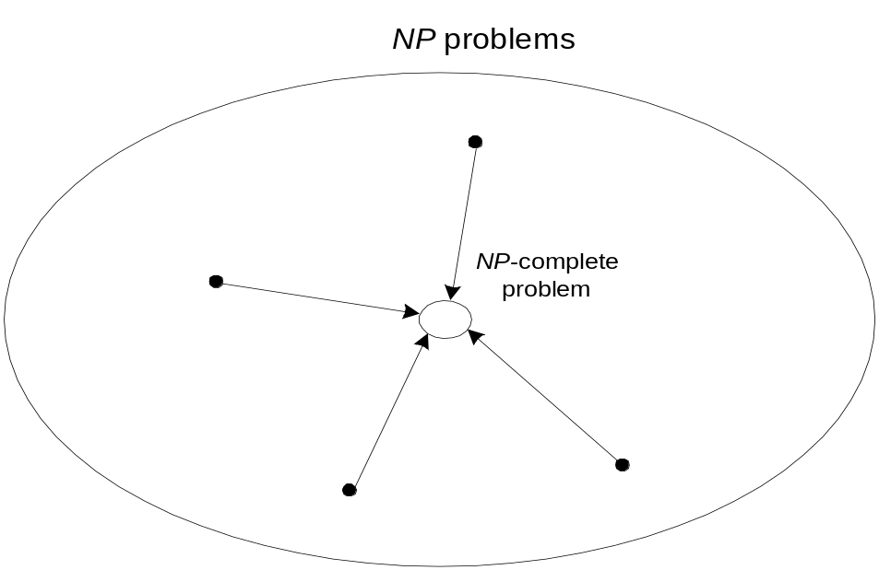
NP-Complete Problems
A decision problem D is NP-complete if it’s as hard as any
problem in NP, i.e.,
D is in NP
every problem in NP is polynomial-time reducible to D
Cook’s theorem (1971): CNF-sat is NP-complete

Slide 9
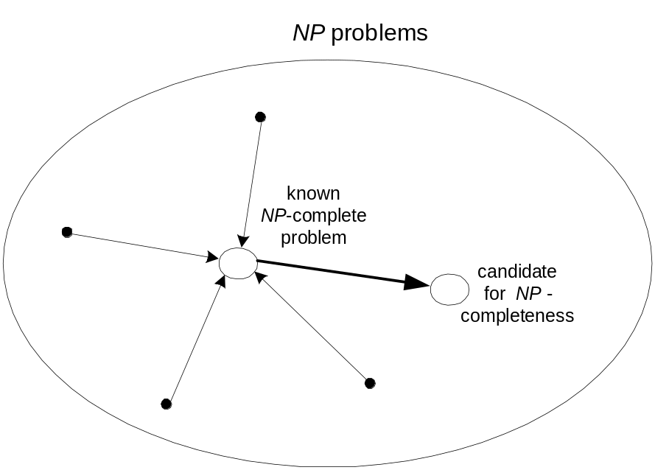
NP-Complete Problems (cont.)
Other NP-complete problems obtained through polynomial-
time reductions from a known NP-complete problem
Examples: TSP, knapsack, partition, graph-coloring and
hundreds of other problems of combinatorial nature

Slide 10
P = NP ? Dilemma Revisited
P = NP would imply that every problem in NP, including all NP-complete problems, could be solved in polynomial time
If a polynomial-time algorithm for just one NP-complete problem is discovered, then every problem in NP can be solved in polynomial time, i.e., P = NP
Most but not all researchers believe that P ≠ NP , i.e. P is a proper subset of NP

Slide 11
APPROXIMATION ALGORITHMS

Slide 12
Approximation Approach
Apply a fast (i.e., a polynomial-time) approximation algorithm to get a solution that is not necessarily optimal but hopefully close to it
Accuracy measures:
accuracy ratio of an approximate solution s_{a}
r(s_{a}) = f(s_{a}) / f(s*) for minimization problems
r(s_{a}) = f(s*) / f(s_{a}) for maximization problems
where f(s_{a}) and f(s*) are values of the objective function f for the approximate solution s_{a} and actual optimal solution s*
performance ratio of the algorithm A
the lowest upper bound of r(s_{a}) on all instances

Slide 13
Nearest-Neighbor Algorithm for TSP
Starting at some city, always go to the nearest unvisited city, and, after visiting all the cities, return to the starting one
A B
D C
Note: Nearest-neighbor tour may depend on the starting city
Accuracy: R_{A} = ∞ (unbounded above) – make the length of AD
arbitrarily large in the above example
1
s_{a} : A – B – C – D – A of length 10
s* : A – B – D – C – A of length 8
6
2
3
3
1

Slide 14
Multifragment-Heuristic Algorithm
Stage 1: Sort the edges in nondecreasing order of weights.
Initialize the set of tour edges to be constructed to
empty set
Stage 2: Add next edge on the sorted list to the tour, skipping
those whose addition would’ve created a vertex of
degree 3 or a cycle of length less than n. Repeat
this step until a tour of length n is obtained
Note: R_{A} = ∞, but this algorithm tends to produce better tours
than the nearest-neighbor algorithm

Slide 15
Twice-Around-the-Tree Algorithm
Stage 1: Construct a minimum spanning tree of the graph
(e.g., by Prim’s or Kruskal’s algorithm)
Stage 2: Starting at an arbitrary vertex, create a path that goes
twice around the tree and returns to the same vertex
Stage 3: Create a tour from the circuit constructed in Stage 2 by
making shortcuts to avoid visiting intermediate vertices
more than once
Note: R_{A} = ∞ for general instances, but this algorithm tends to
produce better tours than the nearest-neighbor algorithm

Slide 16
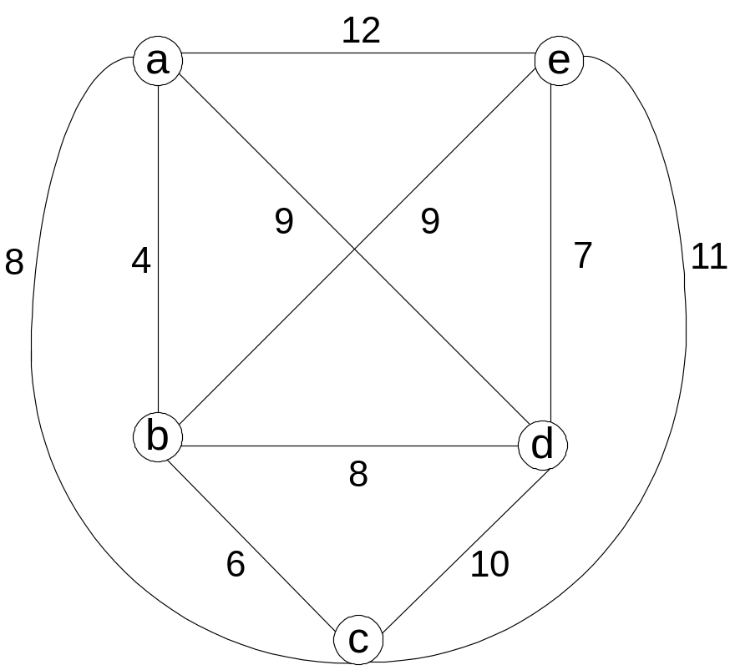
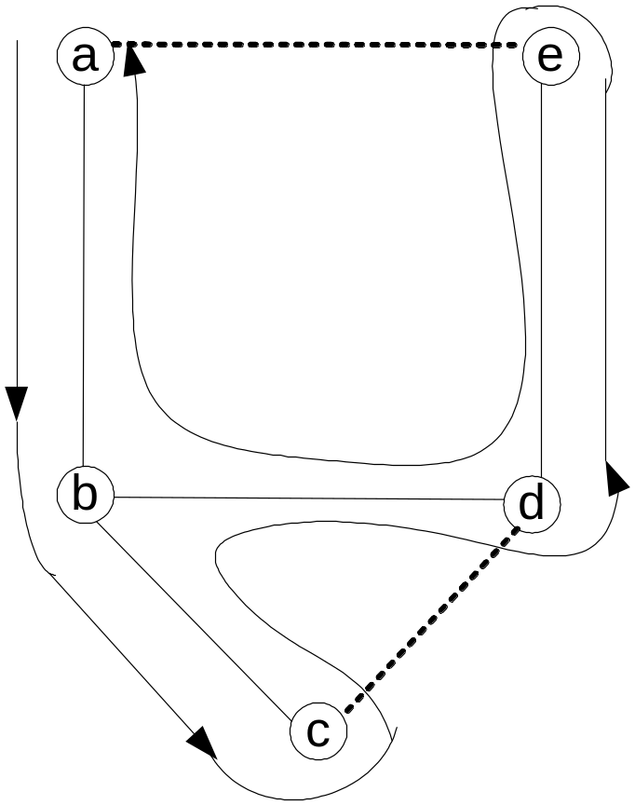
Example
Walk: a – b – c – b – d – e – d – b – a Tour: a – b – c – d – e – a

Slide 17
Christofides Algorithm
Stage 1: Construct a minimum spanning tree of the graph
Stage 2: Add edges of a minimum-weight matching of all the odd
vertices in the minimum spanning tree
Stage 3: Find an Eulerian circuit of the multigraph obtained in
Stage 2
Stage 3: Create a tour from the path constructed in Stage 2 by
making shortcuts to avoid visiting intermediate vertices
more than once
R_{A} = ∞ for general instances, but it tends to produce better
tours than the twice-around-the-minimum-tree alg.

Slide 18
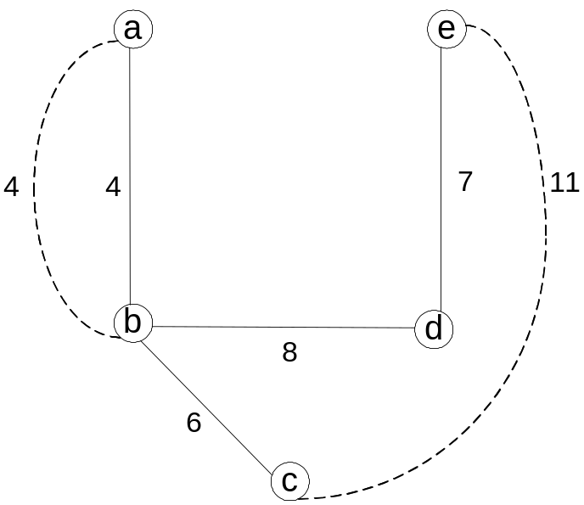
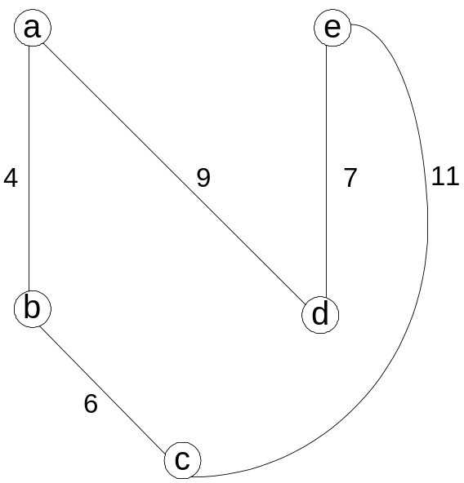
Example: Christofides Algorithm

Slide 19
Euclidean Instances
Theorem If P ≠ NP, there exists no approximation algorithm
for TSP with a finite performance ratio.
Definition An instance of TSP is called Euclidean, if its
distances satisfy two conditions:
1. symmetry d[i, j] = d[j, i] for any pair of cities i and j
2. triangle inequality d[i, j] ≤ d[i, k] + d[k, j] for any cities i, j, k
For Euclidean instances:
approx. tour length / optimal tour length ≤ 0.5(⌈log₂ n⌉ + 1)
for nearest neighbor and multifragment heuristic;
approx. tour length / optimal tour length ≤ 2
for twice-around-the-tree;
approx. tour length / optimal tour length ≤ 1.5
for Christofides

Slide 20
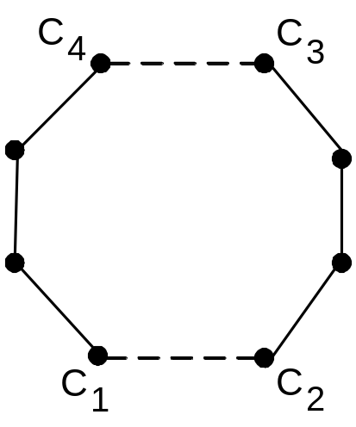
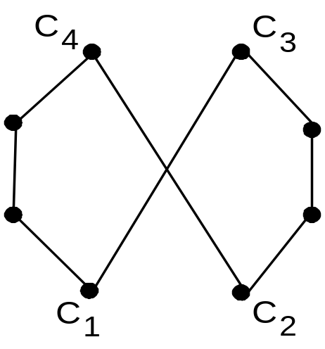
Local Search Heuristics for TSP
Start with some initial tour (e.g., nearest neighbor). On each iteration, explore the current tour’s neighborhood by exchanging a few edges in it. If the new tour is shorter, make it the current tour; otherwise consider another edge change. If no change yields a shorter tour, the current tour is returned as the output.
Example of a 2-change

Slide 21
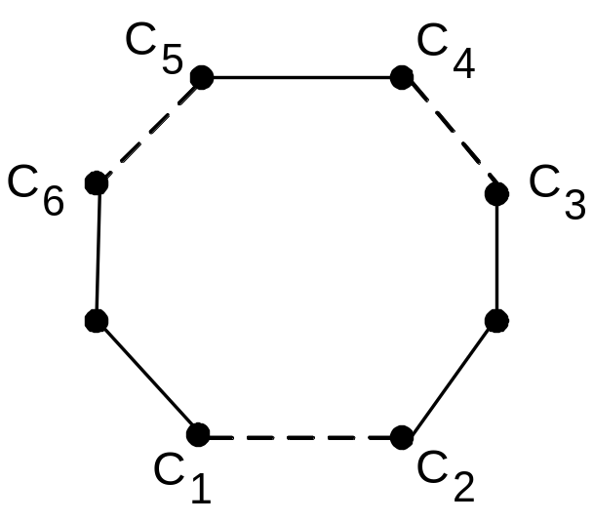
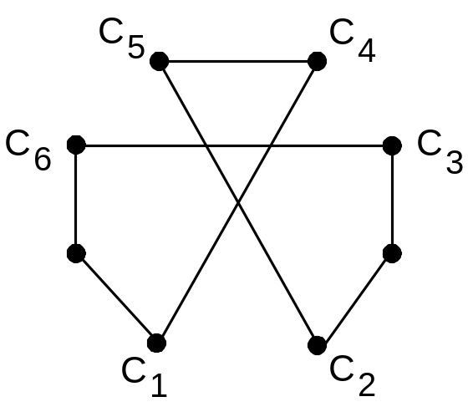
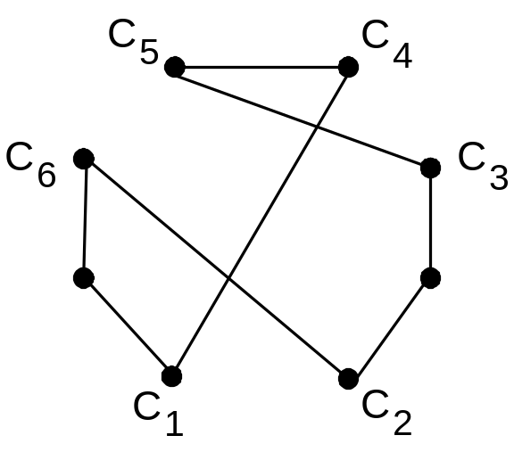
Example of a 3-change

Slide 22
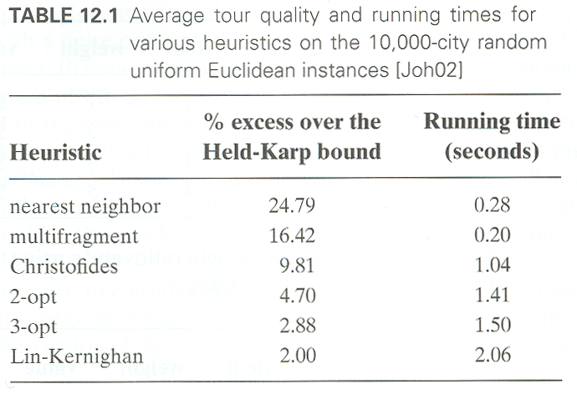
Empirical Data for Euclidean Instances

Slide 23
Greedy Algorithm for Knapsack Problem
Step 1: Order the items in decreasing order of relative values:
v₁/w₁≥… ≥ v_{n}/w_{n}
Step 2: Select the items in this order skipping those that don’t
fit into the knapsack
Example: The knapsack’s capacity is 16
item weight value v/w
1 2 $40 20
2 5 $30 6
3 10 $50 5
4 5 $10 2
Accuracy
R_{A} is unbounded (e.g., n = 2, C = m, w₁=1, v₁=2, w₂=m, v₂=m)
yields exact solutions for the continuous version

Slide 24
Approximation Scheme for Knapsack Problem
Step 1: Order the items in decreasing order of relative values:
v₁/w₁≥… ≥ v_{n}/w_{n}
Step 2: For a given integer parameter k, 0 ≤ k ≤ n, generate all
subsets of k items or less and for each of those that fit the
knapsack, add the remaining items in decreasing
order of their value to weight ratios
Step 3: Find the most valuable subset among the subsets generated in Step 2 and return it as the algorithm’s output
Accuracy: f(s*) / f(s_{a}) ≤ 1 + 1/k for any instance of size n
Time efficiency: O(kn^{k+1})
There are fully polynomial schemes: algorithms with polynomial running time as functions of both n and k

Slide 25
Bin Packing Problem: First-Fit Algorithm
First-Fit (FF) Algorithm: Consider the items in the order given and place each item in the first available bin with enough room for it; if there are no such bins, start a new one
Example: n = 4, s₁ = 0.4, s₂ = 0.2, s₃ = 0.6, s₄ = 0.7
Accuracy
Number of extra bins never exceeds optimal by more than
70% (i.e., R_{A} ≤ 1.7)
Empirical average-case behavior is much better. (In one
experiment with 128,000 bins, the relative error was found
to be no more than 2%.)

Slide 26
Bin Packing: First-Fit Decreasing Algorithm
First-Fit Decreasing (FFD) Algorithm: Sort the items in decreasing order (i.e., from the largest to the smallest). Then proceed as above by placing an item in the first bin in which it fits and starting a new bin if there are no such bins
Example: n = 4, s₁ = 0.4, s₂ = 0.2, s₃ = 0.6, s₄ = 0.7
Accuracy
Number of extra bins never exceeds optimal by more than
50% (i.e., R_{A} ≤ 1.5)
Empirical average-case behavior is much better, too

